Slide 1
Lighting Up Your Light
To Brighten Your World!

Slide 2
Phōteinos: Composed of light, of a bright character, full of light…
Mat 6:22 NKJV
"The lamp of the body is the eye. If therefore your eye is good, your whole body will be full of light. But if your eye is bad, your whole body will be full of darkness. If therefore the light that is in you is darkness, how great [is] that darkness!
Phōs:
the light emitted by a lamp
Skotos:
Darkness of night, ignorance respecting divine things and human duties, and the accompanying ungodliness and immorality

Slide 3
These Scriptures Suggest that
Darkness is the Absence of Light
Is that Literally True or is it a Metaphor?

Slide 4

Black
Darkness as we see on the left is in fact “the absence light” because all “light” colors are set to “zero” .

Slide 5
If Darkness is the Absence of Light
It Begs the Question
What is the Composition of Light?

Slide 6
Black
If the absence of all Light is the “Composition of Darkness (Black)”, what then would be the “Composition of Light (White)”?

Slide 7
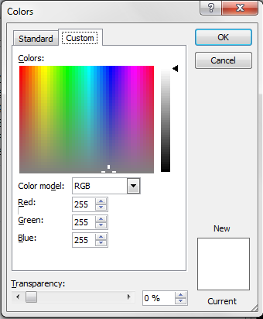
Light
The “Composition of Light (White)” is equal amounts of Red, Green, and Blue.

Slide 8
Stop
Justice
[Matthew 23:23 NKJV]
"Woe to you, scribes and Pharisees, hypocrites! For you pay tithe of mint and anise and cummin, and have neglected the weightier [matters] of the law: justice and mercy and faith. These you ought to have done, without leaving the others undone.
Go
Mercy
Trust
Faith

Slide 10
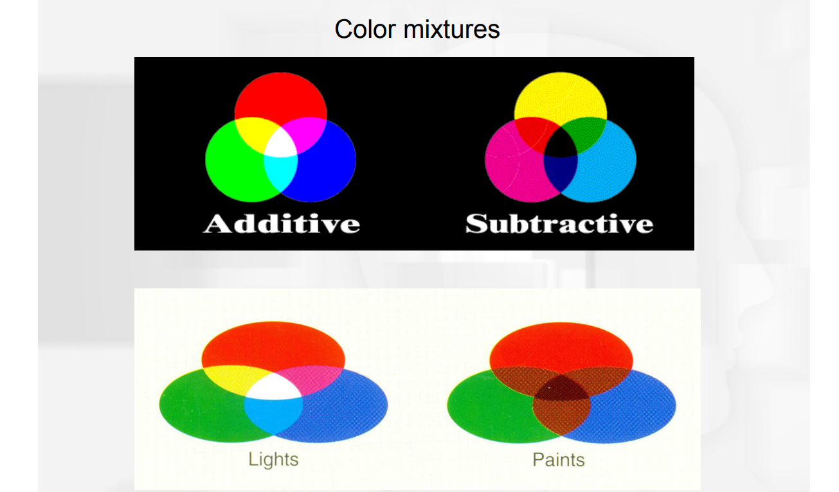

Slide 11
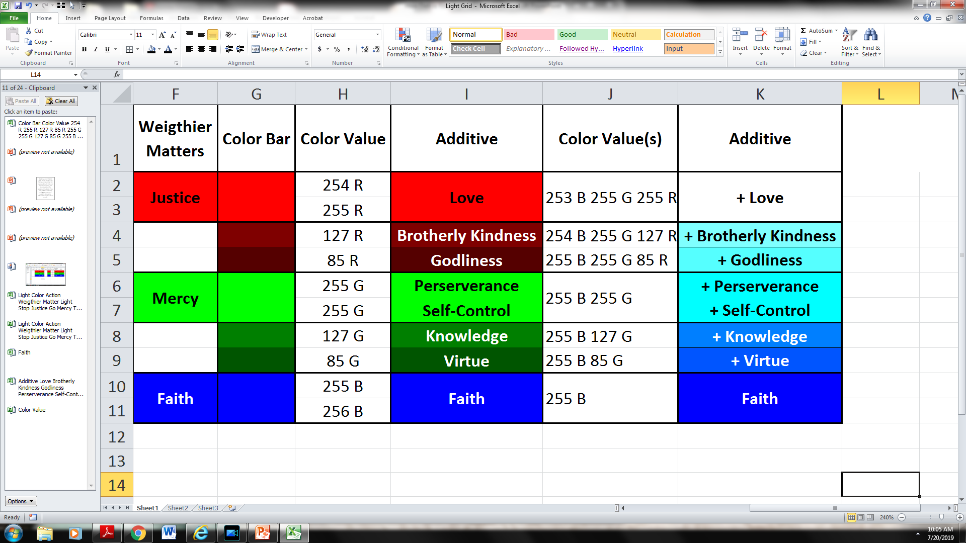

Slide 13
[2 Peter 1:5-7 NKJV]
But also for this very reason, giving all diligence,
1) add to your faith virtue,
2) to virtue knowledge,
3) to knowledge self-control,
4) to self-control perseverance,
5) to perseverance godliness,
6) to godliness brotherly kindness,
7)and to brotherly kindness love.

Slide 14
[2 Peter 1:5-7 NKJV]
But also for this very reason, giving all diligence,
7)and to brotherly kindness love.
[1 John 5:3]
For this is the love of God, that we keep His commandments. And His commandments are not burdensome.

Slide 16
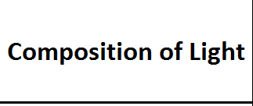

Slide 24
Lighting Up Your Light
Involves a Process of Addition
Built Upon An Indispensable Fundamental
FAITH

Slide 25
[2 Peter 1:5-7 NKJV]
But also for this very reason, giving all diligence,
1) add to your faith virtue,
2) to virtue knowledge,
3) to knowledge self-control,
4) to self-control perseverance,
5) to perseverance godliness,
6) to godliness brotherly kindness,
7)and to brotherly kindness love.

Slide 26
[2 Peter 1:1-4 NKJV]
Simon Peter, a bondservant and apostle of Jesus Christ, To those who have obtained like precious faith with us by the righteousness of our God and Savior Jesus Christ:
Grace and peace be multiplied to you in the knowledge of God and of Jesus our Lord, as His divine power has given to us all things that [pertain] to life and godliness, through the knowledge of Him who called us by glory and virtue, by which have been given to us exceedingly great and precious promises, that through these you may be partakers of the divine nature, having escaped the corruption [that is] in the world through lust.

Slide 27
[2 Peter 1:5-7 NKJV]
But also for this very reason, giving all diligence,
1) add to your faith virtue,
2) to virtue knowledge,
3) to knowledge self-control,
4) to self-control perseverance,
5) to perseverance godliness,
6) to godliness brotherly kindness,
7)and to brotherly kindness love.

Slide 28
[Hebrews 11:1 NKJV]
Now faith is the substance of things hoped for, the evidence of things not seen.

Slide 29
[Hebrews 11:3 NKJV]
By faith we understand that the worlds were framed by the word of God, so that the things which are seen were not made of things which are visible.

Slide 30
[Hebrews 11:6]
But without faith [it is] impossible to please [Him], for he who comes to God must believe that He is, and [that] He is a rewarder of those who diligently seek Him.

Slide 31
[Hebrews 11:6]
But without faith [it is] impossible to please [Him], for he who comes to God must believe that He is, and [that] He is a rewarder of those who diligently seek Him.

Slide 32
[John 6:44]
No one can come to Me unless the Father who sent Me draws him; and I will raise him up at the last day.

Slide 33
[Genesis 12:1-5]
Now the LORD had said to Abram: "Get out of your country, From your family And from your father's house, To a land that I will show you.
I will make you a great nation; I will bless you And make your name great; And you shall be a blessing.
I will bless those who bless you, And I will curse him who curses you; And in you all the families of the earth shall be blessed."
So Abram departed as the LORD had spoken to him, and Lot went with him. And Abram [was] seventy-five years old when he departed from Haran.

Slide 34
[Ephesians 2:8-9]
For by grace you have been saved through faith, and that not of yourselves; [it is] the gift of God, not of works, lest anyone should boast.
For we are His workmanship, created in Christ Jesus for good works, which God prepared beforehand that we should walk in them.

Slide 35
Start With the Gift of
FAITH

Slide 36
[2 Peter 1:5-7 NKJV]
But also for this very reason, giving all diligence,
1) add to your faith virtue,

Slide 37
[2 Peter 1:5-7 NKJV]
But also for this very reason, giving all diligence,

Slide 38
[Proverbs]
Pro 1:7 NKJV - The fear of the LORD [is] the beginning of knowledge, [But] fools despise wisdom and instruction.
Pro 1:29 NKJV - Because they hated knowledge And did not choose the fear of the LORD,
Pro 2:5 NKJV - Then you will understand the fear of the LORD, And find the knowledge of God.
Pro 9:10 NKJV - "The fear of the LORD [is] the beginning of wisdom, And the knowledge of the Holy One [is] understanding.

Slide 39
[2 Peter 1:5-7 NKJV]
But also for this very reason, giving all diligence,
3) to knowledge self-control,

Slide 40
[2 Peter 1:5-7 NKJV]
But also for this very reason, giving all diligence,
3) to knowledge self-control,
[Psa 119:66 NKJV]
Teach me good judgment and knowledge, For I believe Your commandments.

Slide 41
[2 Peter 1:5-7 NKJV]
But also for this very reason, giving all diligence,
3) to knowledge self-control,
[Psa 119:66 NKJV]
Teach me good judgment and knowledge, For I believe Your commandments.
[Psa 119:1 ESV]
Blessed are those whose way is blameless, who walk in the law of the LORD!

Slide 42
[2 Peter 1:5-7 NKJV]
But also for this very reason, giving all diligence,
4) to self-control perseverance,

Slide 43
[2 Peter 1:5-7 NKJV]
But also for this very reason, giving all diligence,
5) to perseverance godliness,

Slide 44
[2 Peter 1:5-7 NKJV]
But also for this very reason, giving all diligence,
6) to godliness brotherly kindness,

Slide 45
[2 Peter 1:5-7 NKJV]
But also for this very reason, giving all diligence,
6) to godliness brotherly kindness,
[1 John 5:3]
For this is the love of God, that we keep His commandments. And His commandments are not burdensome.

Slide 46
[2 Peter 1:5-7 NKJV]
But also for this very reason, giving all diligence,
1) add to your faith virtue,
2) to virtue knowledge,
3) to knowledge self-control,
4) to self-control perseverance,
5) to perseverance godliness,
6) to godliness brotherly kindness,
7)and to brotherly kindness love.

Slide 47
[1 Peter 1:8 - 11]
For if these things are yours and abound, [you] will be neither barren nor unfruitful in the knowledge of our Lord Jesus Christ.
For he who lacks these things is shortsighted, even to blindness, and has forgotten that he was cleansed from his old sins.
Therefore, brethren, be even more diligent to make your call and election sure, for if you do these things you will never stumble;
for so an entrance will be supplied to you abundantly into the everlasting kingdom of our Lord and Savior Jesus Christ.

Slide 48
Start With the Gift of
FAITH
And Add to It Till You Have the Gift of JUSTICE
And It Will Brighten Up Your World

